Slide 1

CHAPTER FOUR
OBJECTS AND CLASSES
By: Behayilu M.
Faculty of Computing and Software Engineerig,
Arba Minch Institute of Technology(AMiT),
Arba Minch University

Slide 2
By the end of this session, students will be able to
To understand and write object oriented programming paradigm
To understand object oriented concepts like class and object
The difference between constructor and method
Understand packages in java

Slide 3
Introduction
Object-oriented programming System(OOPs) is a programming paradigm based on the concept of “objects” that contain data and methods.
The primary purpose of object-oriented programming is to increase the flexibility and maintainability of programs.
Object oriented programming brings together data and its behavior(methods) in a single location(object) makes it easier to understand how a program works.

Slide 4
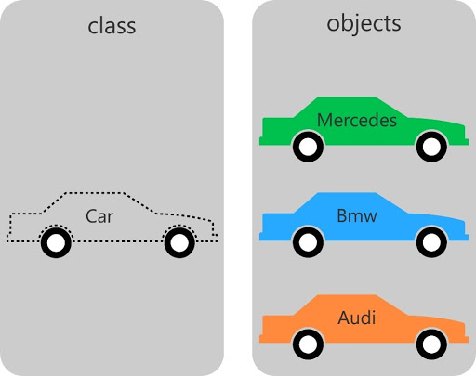
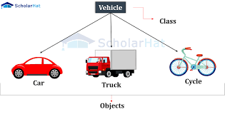
Object - Objects have states and behaviors. Example: A dog has states - color, name, breed as well as behaviors -wagging, barking, and eating.
An object is an instance of a class.
Class - A class can be defined as a template/blue print that describes the behaviors/states that object of its type support.

Slide 5
Objects in Java
If you compare the software object with a real world object, they have very similar characteristics.
Software objects also have a state and behavior.
A software object's state is stored in fields and behavior is shown via methods.
So in software development, methods operate on the internal state of an object and the object-to-object communication is done via methods.
Objects have two characteristics: They have states and behaviors.

Slide 6
Classes in Java
A class is a blue print from which individual objects are created.
A class is a description of a kind of object.
A programmer may define a class using Java, or may use predefined classes that come in class libraries.

Slide 7
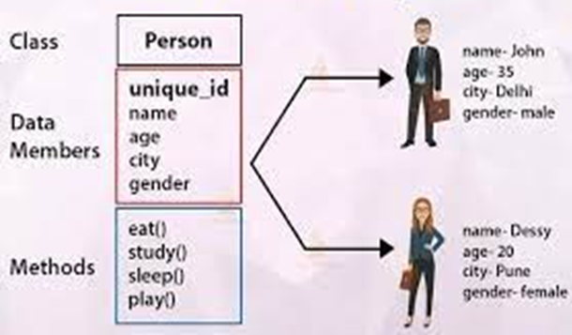
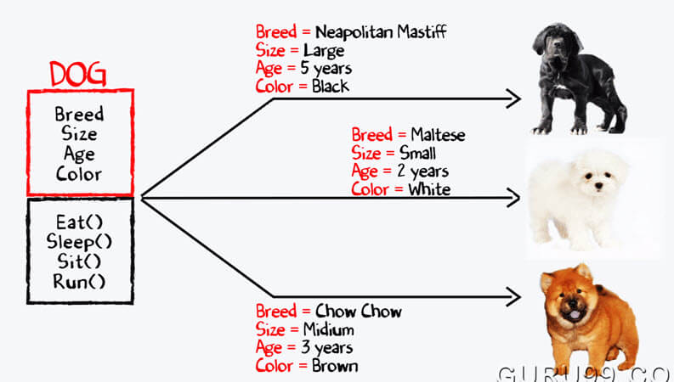
Classes in Java

Slide 8
A sample of a class is given below:
public class Dog
{
String breed;
int age; states …fields ..variables
String color;
public void barking(){
}
public void hungry(){ behaviors…methods
}
public void sleeping(){
}
}

Slide 9
…cont’d
A class is merely a plan for a possible object.
It does not by itself create any objects.
When a programmer wants to create an object the new operator is used with the name of the class.
Creating an object is called instantiation.

Slide 10
Constructors in java
Constructor is a block of code that initializes the newly created object.
The constructor name matches with the class name and it doesn’t have a return type.
A constructor is called automatically when a new instance of an object is created.
A simple constructor program in java
The new keyword here creates the object of classStudent and invokes the constructor to initialize this newly created object.
In this example we have used this keyword, which refers to the current object obj1 in this example.

Slide 11
public class Student
{
String name;
//Constructor
public Student( )
{
this.name = “John";
}
public static void main(String[] args)
{
Student obj1 = new Student( );
System.out.println(obj.name);
}
}
name
John
obj1

Slide 12
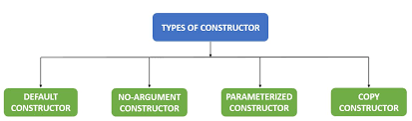
Types of constructors
There are four types of constructors: Default, No-arg constructor, Parameterized and Copy constructor.

Slide 13
Default constructor
If you do not implement any constructor in your class, Java compiler inserts a default constructor into your code on your behalf.
You would not find it in your source code (the java file) as it would be inserted into the code during compilation and exists in .class file.
This process is shown in the diagram below:

Slide 14
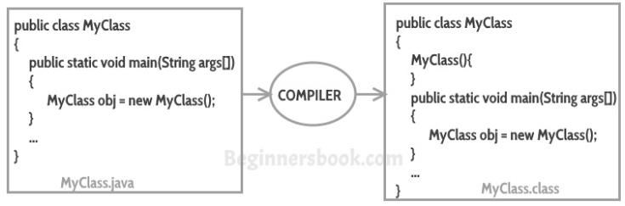
Note: If you implement any constructor then you no longer receive a default constructor from Java compiler.

Slide 15
No-arg constructor
Constructor with no arguments is known as no-arg constructor.
The signature is same as default constructor; however body can have any code unlike default constructor where the body of the constructor is empty.

Slide 16
Example: no-arg constructor
public class Demo
{
public Demo()
{
System.out.println("This is a no argument constructor");
}
public static void main(String args[])
{
Demo obj=new Demo();
}
}
Output: This is a no argument constructor

Slide 17
Parameterized constructor
Constructor with arguments (or you can say parameters) is known as Parameterized constructor.
Example

Slide 18
public class Employee {
int empId;
String empName;
//parameterized constructor with two parameters
public Employee(int id, String name){
this.empId = id;
this.empName = name;
}
public void info(){
System.out.println("Id: "+empId+" Name: "+empName);
}
public static void main(String args[]){
Employee obj1 = new Employee(10245,“Hellen");
Employee obj2 = new Employee(92232,“Daniel");
obj1.info();
obj2.info();
}
}
Output
Id: 10245 Name: Hellen
Id: 92232 Name: Daniel

Slide 19
public class Example2
{
private int var;
public Example2() {
this.var = 10;
}
//parameterized constructor
public Example2(int num) {
this.var = num;
}
public int getValue() {
return var;
}
public static void main(String args[])
{
Example2 obj1 = new Example2();
Example2 obj2 = new Example2(100);
System.out.println("var is: "+obj1.getValue());
System.out.println("var is: "+obj2.getValue());
}
}
Output
var is: 10
var is: 100

Slide 20
Copy Constructor
In Java, a copy constructor is a special type of constructor that creates an object using another object of the same Java class.
It returns a duplicate copy of an existing object of the class.

Slide 21
public class Car
{
public String model;
public String color;
// Parameterized Constructor
public Car(String model, String color)
{
this.model = model;
this.color = color;
}
//Copy Constructor
public Car(Car c)
{
this.model = c.model;
this.color = c.color;
}
public static void main(String[] args)
{
Car c1 = new Car("Toyota ", "Brown");
// here a copy constructor is being called.
Car c2 = new Car(c1);
System.out.println(c1.model + " " + c1.color);
System.out.println(c2.model + " " + c2.color);
}
}
Toyota Brown
Toyota Brown

Slide 22
Difference between Constructor and Method
1. The purpose of constructor is to initialize the object of a class while the purpose of a method is to perform a task by executing java code.
2. The name of the constructor must be the same as the name of the class.
3. A constructor is called automatically when a new instance of an object is created.
4. Constructors do not have return types while methods do.

Slide 23
Types of variables
There are 3 types of variables in java
1. Local variable:- a variable which is declared inside a method is called local variable.
2. Instance variable:- a variable which is declared inside the class but outside the method.
3. Static variable (class variable):-a variable that is declared as static is called static variable.
It can not be local.
It is common for all instance of classes.

Slide 24
Example
public class A
{
public int data =50; // instance variable
public static int m=100; //static variable
public static void main(String args[])
{
int n=90; // local variable
}
}

Slide 25
Methods
Methods define behavior.
A Method is a collection of statements that are grouped together to perform an operation.
Sometimes, a program uses the same code but at different places(so we can not use loops).
Having multiple copies of the same code is very bad software design.
System.out.println() is an example of a built in method.
You can define your own methods to perform your desired tasks.

Slide 26
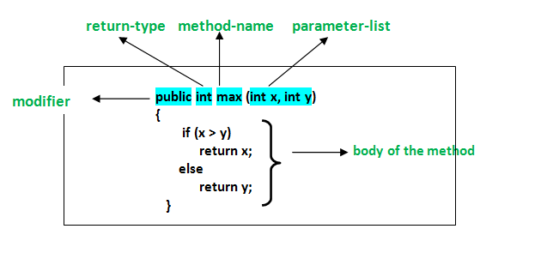
Advantage of using methods
Code reuse: you can write a method once, and use it multiple times, without having to write the code each time.
Separating a code into a modular methods is easy to design and understand.

Slide 27
Types of Methods
There are two types of methods in Java
Predefined Method
User-defined Method
In Java, predefined methods are the method that is already defined in the Java class libraries is known as predefined methods.
It is also known as the standard library method or built-in method. We can directly use these methods just by calling them in the program at any point.
Some pre-defined methods are length(), equals(), compareTo(), sqrt(), etc.

Slide 28
User-defined Method
The method written by the user or programmer is known as a user-defined method.
These methods are modified according to the requirement.
public class Myclass
{
public static void sayHello( ) // method definition or method body
{
System.out .println(“Hello world”);
}
public static void main(String args[])
{
sayHello( ); // method calling
}
}
Hello world

Slide 29
…cont’d
The code above declares a method called “sayHello()”, which prints a text, and then gets called a main.
To call a method, type its name and then follow the name with a setoff parenthesis.
You can call a method as may times as necessary.
When a method runs, the code jumps down to where the method is define, executes the code inside of it, then goes back and proceeds to the next line.

Slide 30
Example 2
public class Myclass
{
public static void sayHello()
{
System.out .println(“Hello world”);
}
public static void main(String args[])
{
sayHello( );
sayHello( );
sayHello( );
}
}
Hello world
Hello world
Hello world

Slide 31
Method parameters
You can also create a method that takes some data, called parameters, along with it when you call it.
Types of methods parameters
A method with no parameter and no return type
A method with parameter and no return type
A method with no parameter and return type
A method with parameter and return type

Slide 32
public class Sample
{
public static void main(String args[])
{
int s,sum=0;
sayHello( );
sayHello(“John”);
s=square( );
sum=add(10,10);
System.out.println(s);
System.out.println(sum);
}
public static void sayHello( ){
System.out.println(“Hello G2 Comp”);
}
public static void sayHello(String name )
{
System.out.println(“Hello”+ name);
}
public static int square( )
{
int r=4;
return (r*r);
}
public static int add(int x, int y)
{
int c;
c=x+y;
return c;
}
}
Hello G2 Comp
Hello John
16
20

Slide 33
Types of methods
There are two types of methods in java
Instance methods
Static methods(class methods)
Instance methods are methods which require an object of its class to be created before it can be called.
Static methods are the methods in Java that can be called without creating an object of class.

Slide 34
Instance method
public class MyMath
{
public double PI=3.14;
public double square(double x)
{
return x*x;
}
public static void main(String args[])
{
MyMath m=new MyMath( );
System.out.println(“m value of PI is ”+m.PI);
System.out.println(“m.square of 5 is “+m.square(5));
}
}
m value of PI is 3.14
m.square of 5 is 25.0

Slide 35
b) Static method
public class MyMath
{
public static double PI=3.14;
public static double square(double x)
{
return x*x;
}
public static void main(String args[])
{
System.out.println(“value of PI is ”+MYMath.PI);
System.out.println(“square of 5 is “+MyMath.square(5));
}
}
value of PI is 3.14
square of 5 is 25

Slide 36
Packages in java
A Package as the name suggests is a pack (group) of classes, interfaces and other packages.
In java we use packages to organize our classes and interfaces.
We have two types of packages in Java
built-in packages and
the packages we can create (also known as user defined package).
In this topic we will learn what packages are, what are user-defined packages in java and how to use them.

Slide 37
…cont’d
In java, we have several built-in packages or pre-defined packages and these packages contain large numbers of classes and interfaces that we used in java.
For example when we need user input, we import a package like this:
import java.util.Scanner;
When we need random number from computer we import this package and so on.
import java.util.Random;
import java.applet.Applet;
Import java.awt.Graphics;

Slide 38
…cont’d
Advantages of using a package in Java
Java package is used to categorize the classes and interfaces so that they can be easily maintained.
Java package provides access protection.
Java packages removes naming collision.

Slide 39
To create a class inside a package, declare the package name in the first statement in your program.
A class can have only one package declaration. Sample.java file created inside a package pack.
The package keyword is used to create a package in java.
package pack;
public class Sample {
public static void main(String args[])
{
System.out.println(“Hello world”);
}
}
How to compile java package >> javac -d . Sample.java
How to run java package >> java pack.Sample

Slide 40
How to access packages from another package
The import keyword is used to make the classes and interfaces of another package accessible to the current package.
There are three ways to access the package from outside the package.
import package.*;
import package.classname;
Fully qualified name
If you use package .* then all the classes and interfaces of this package will be accessible.
Order
package declaration
package import

Slide 41
//save by A.java package a1; public class A{ public void msg( ) { { System.out.println(“inside class A”); } }
//save by B.java package a2; import a1.*;//import all classes on this package public class B{ public static void main(String args[] ) { A ob=new A( ); ob.msg( ); } }

Slide 42
//save by A.java package a1; public class A{ public void msg( ) { { System.out.println(“inside class A”); } }
//save by B.java package a2; import a1.A;//Import by selecting the class public class B{ public static void main(String args[] ) { A ob=new A( ); ob.msg( ); } }

Slide 43
//save by A.java package a1; public class A{ public void msg( ) { { System.out.println(“inside class A”); } }
//save by B.java package a2; public class B{ public static void main(String args[] ) { a1.A ob=new a1.A( );//Using fully qualified name ob.msg( ); } }

Slide 44
Java access modifiers
An access modifier restricts the access of a class, constructor, data member and method in another class.
In java we have 4 access modifiers
default
private
protected
public

Slide 45
Default access modifier
If you don’t use any modifier, it is treated as default by default.
The default modifier is accessible only within class.
b) Private access modifier
The private access modifier is accessible only within class.
c) Protected access modifier
The protected access modifier is accessible within package and outside the package but through inheritance only.
d) Public access modifier
The public access modifier is accessible everywhere
It is the widest scope among all other modifiers.

Slide 46
The scope of access modifiers in tabular form
modifier | class | package | Sub class | world
public | Y | Y | Y | Y
protected | Y | Y | Y | N
No modifier | Y | Y | N | N
Private | Y | N | N | N

